Slide 1
My privacy my decision
Submitted by:
Akshara.Ashokan

Slide 2
abstract
Photo sharing is an attractive feature which popularizes Online Social Networks (OSNs).
Unfortunately, it may leak users privacy if they are allowed to post, comment, and tag a photo freely.
In this project attempt to address this issue and study the scenario when a user shares a photo containing individuals other than himself/herself (termed co-photo for short).

Slide 3
To prevent possible privacy leakage of a photo, we design a mechanism to enable each individual in a photo be aware of the posting activity and participate in the decision making on the photo posting.
For this purpose, we need an efficient facial recognition (FR) system that can recognize everyone in the photo
Our mechanism is implemented as a proof of concept java application on Facebook’s platform.

Slide 4
Module description
User
User is a common social networking user. He can register in facebook and get a login. Also get a request when an anthor user try to tag a photo that including the user.
2. admin
Admin has a login to the socal network(here facebook).Admin will view the users post, he view the stressed users rtc.

Slide 5
About
My topic is “My privacy my decision”. The purpose of this software application is it can be used to identify the posting of our photos in facebook. Using this system we can secure our photos from posting from unknown people
i am doing my project in JSP. Building tools are :
Netbeans
GITHub
Apache Tomcat 7.0.34.0

Slide 6
JSP
JavaServer Pages (JSP) is a technology that helps software developers create dynamically generated web pages based on HTML, XML, or other document types. Released in 1999 by Sun Microsystems,^{[1]} JSP is similar to PHP and ASP, but it uses the Java programming language.
To deploy and run JavaServer Pages, a compatible web server with a servlet container, such as Apache Tomcat or Jetty, is require

Slide 7
Netbeans
NetBeans IDE is a free, open source, integrated development environment (IDE) that enables you to develop desktop, mobile and web applications.
The IDE supports application development in various languages, including Java, HTML5, PHP and C++. The IDE provides integrated support for the complete development cycle, from project creation through debugging, profiling and deployment.
The IDE runs on Windows, Linux, Mac OS X, and other UNIX-based systems.

Slide 8
The IDE provides comprehensive support for JDK 7 technologies and the most recent Java enhancements. It is the first IDE that provides support for JDK 7, Java EE 7, and JavaFX 2.
The IDE fully supports Java EE using the latest standards for Java, XML, Web services, and SQL and fully supports the GlassFish Server, the reference implementation of Java EE.

Slide 9
GitHub
Version control is a system that manages changes to a file or files.
These changes are kept as logs in a history, with detailed information on what file(s) was changed, what was changed within the file, who changed it, and a message on why the change was made.
This is extremely useful, especially when working in teams .

Slide 10
To understand how incredibly powerful version control is,:
How many files of different versions of a manuscript or thesis do you have laying around after getting feedback from your supervisor or co-authors?
Have you ever wanted to experiment with your code or your manuscript and need to make a new file so that the original is not touched ?
Have you ever deleted something and wish you hadn’t ?
Have you ever forgotten what you were doing on a project ?
All these problems are fixed by using version control (git)!

Slide 11
Apache Tomcat
Apache Tomcat, often referred to as Tomcat Server, is an open-source Java Servlet Container developed by the Apache Software Foundation (ASF).
Tomcat implements several Java EE specifications including Java Servlet, JavaServer Pages (JSP), Java EL, and WebSocket, and provides a "pure Java" HTTP web server environment in which Java code can run.
Tomcat is developed and maintained by an open community of developers under the auspices of the Apache Software Foundation, released under the Apache License 2.0 license, and is open-source software.

Slide 12
BUGZILLA
Bugzilla is an open-source issue/bug tracking system that allows developers effectively to keep track of outstanding problems with their product. It is written in Perl and uses MYSQL database.
Bugzilla is a Defect tracking tool, however it can be used as a test management tool as such it can be easily linked with other Test Case management tools like Quality Center, Testlink etc.
This open bug-tracker enables users to stay connected with their clients or employees, to communicate about problems effectively throughout the data-management chain.

Slide 13
Key features of Bugzilla includes
Advanced search capabilities
E-mail Notifications
Modify/file Bugs by e-mail
Time tracking
Strong security
Customization
Localization

Slide 14
EXISTING SYSTEM
Existing system is the facebook platform it cause security issue in posting photos
In which we can create an account, add friends, post our text and photos etc.
But problem with the existing system is anyone can post their photos including our photos without our concern.
So the security is one of the major problem

Slide 15
PROPOSED SYSTEM
Proposed system is also in facebook platform
Proposed system includes the feature of security to the posting of photos
In this system it uses a face identification system which identify each person in the photo
And if our face is identified a request is send
If the person accept the request the post can publish else not post

Slide 16
TABLE DESIGN
Table no :1
Table name: tbl_Adminlogin
Id: Auto increment
Field | type | description
id | Int | Id for admin
name | Varchar | Name of admin
paswrd | Varchar | Password of admin

Slide 17
Table number : 2 table name: tbl_comment id: auto_increment
Field | type | Description
id | int | Comment id
poid | int | Post id
userid | int | Comment user id
comment | varchar | Comment posted
Date | datetime | date of comment

Slide 18
Table number : 3 table name: friend_list frindid: auto_increment
Field | type | description
friendid | int | Friendlist id
userid | int | User id
friendid | int | Friend list
status | tinyint | stastus
reqdate | datetime | Request date
acpdate | datetime | Accept date

Slide 19
Table number :4 table name : message userid: foriegn key
field | type | descrption
userid | int | User id
message | int | Message to user id
content | varchar | Messge content
Date1 | datetime | Date of message
status | int | Satus of the message send

Slide 20
Table number :5 table name :post po_id: primary key
field | type | description
Po_id | int | Post id
userid | int | User id
title | varchar | Title of the post
upload | date | Date of upload
imagif | varchar | Image posted

Slide 21
Table number : 6 table name:postlike
field | type | description
postid | int | Post id
like_id | int | Like user id
Like_status | int | Status like
likedate | date | Date of like

Slide 22
Table number : 7 table name:user
filed | type | description
userid | int | Id of user
firstname | varchar | First name
lastname | varchar | Last name
num | varchar | Contact number
emailid | varchar | Email id
paswrd | varchar | password
gender | varchar | gender
usersta | int | userstatus
profim | varchar | Profile image

Slide 23
UML Diagrams

Slide 24
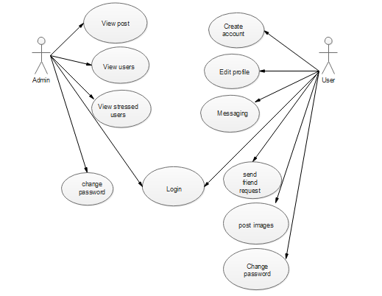
Use-case diagram

Slide 25
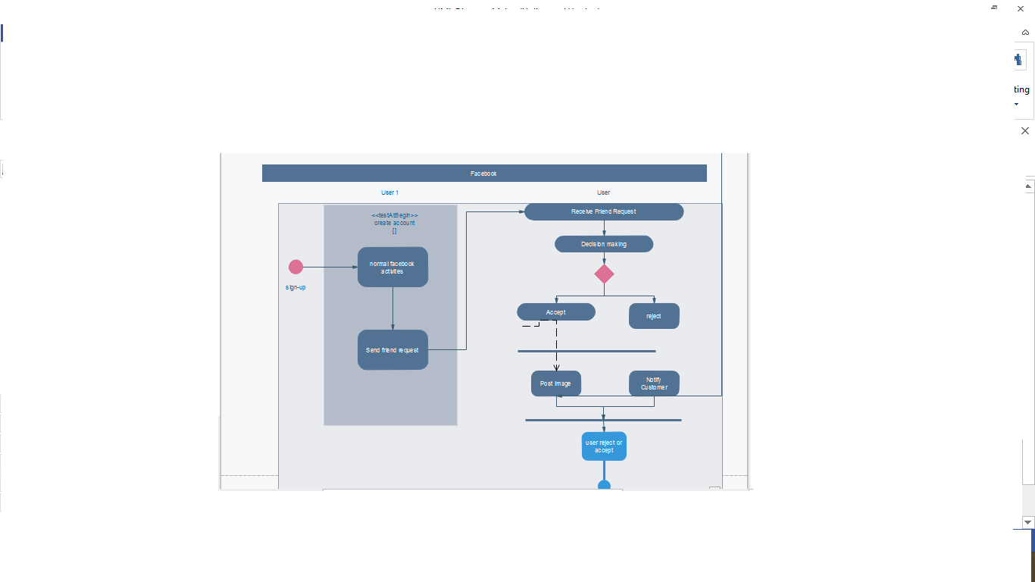
Activity diagram

Slide 26
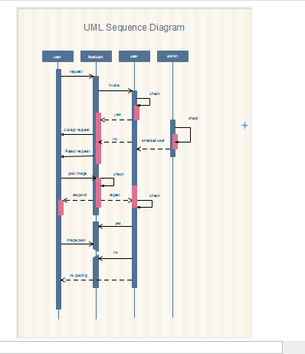
Sequence diagram

Slide 27
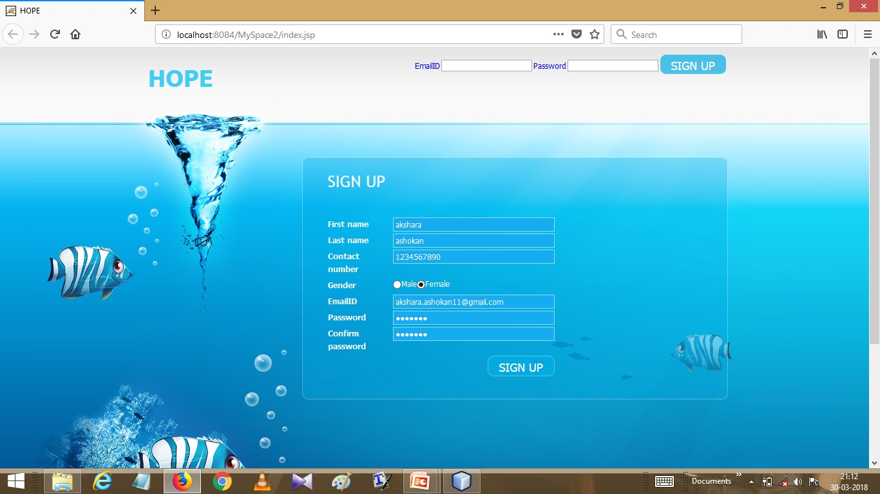
FORMS

Slide 28
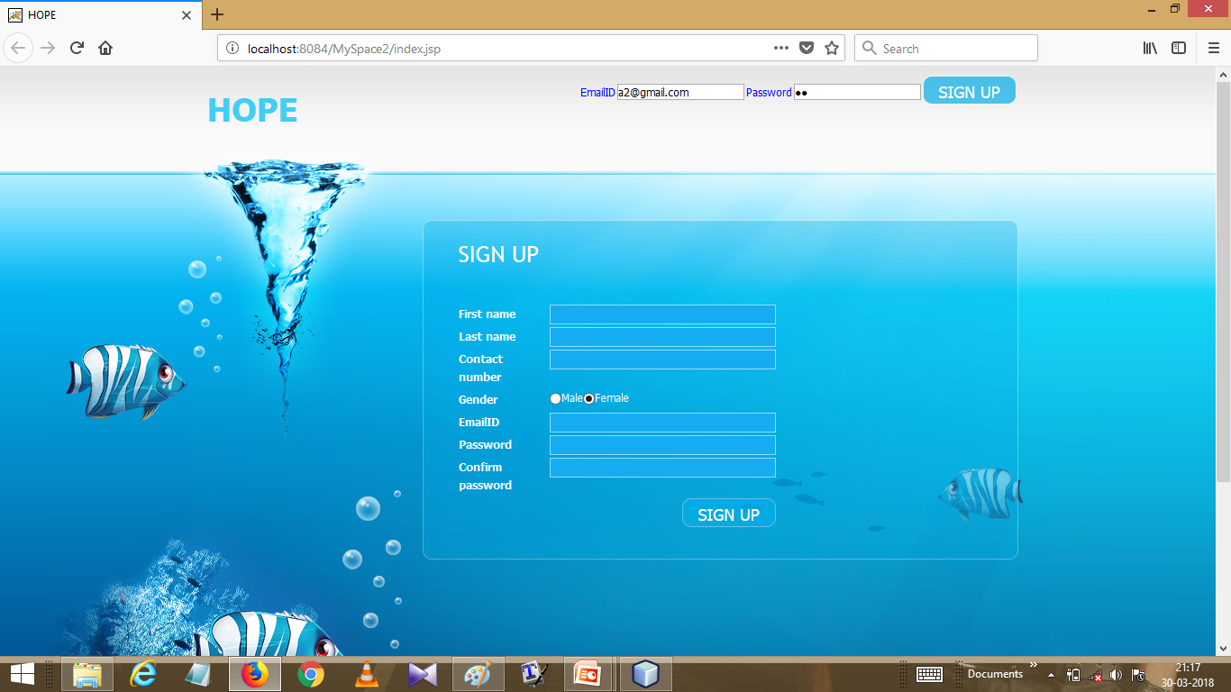

Slide 29
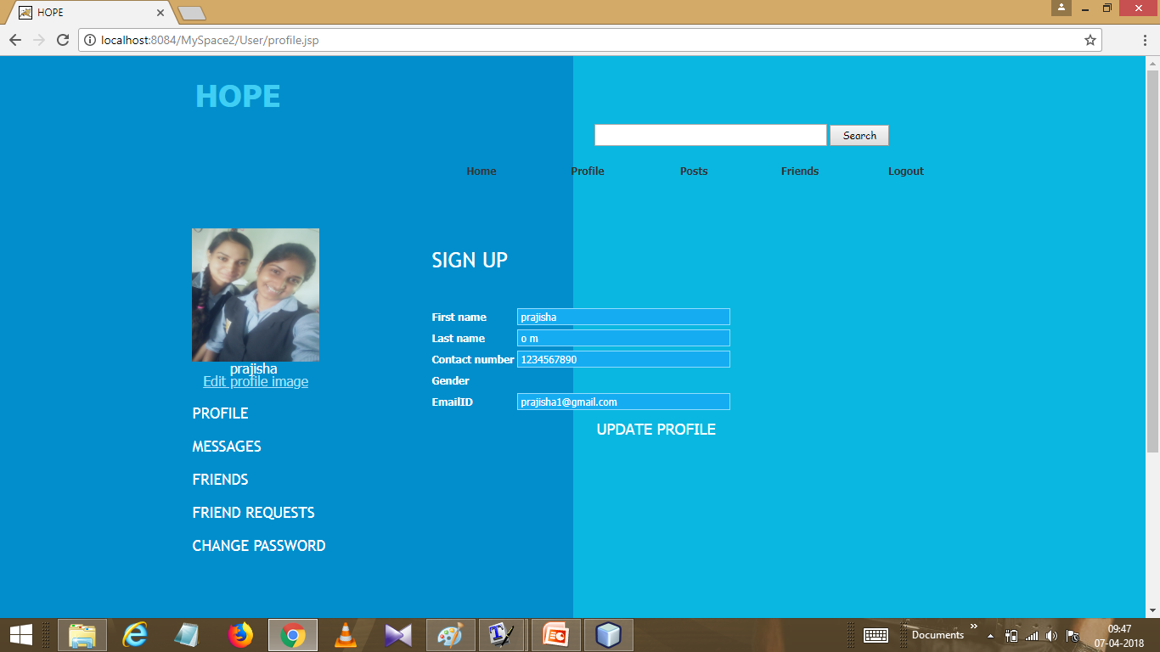

Slide 30
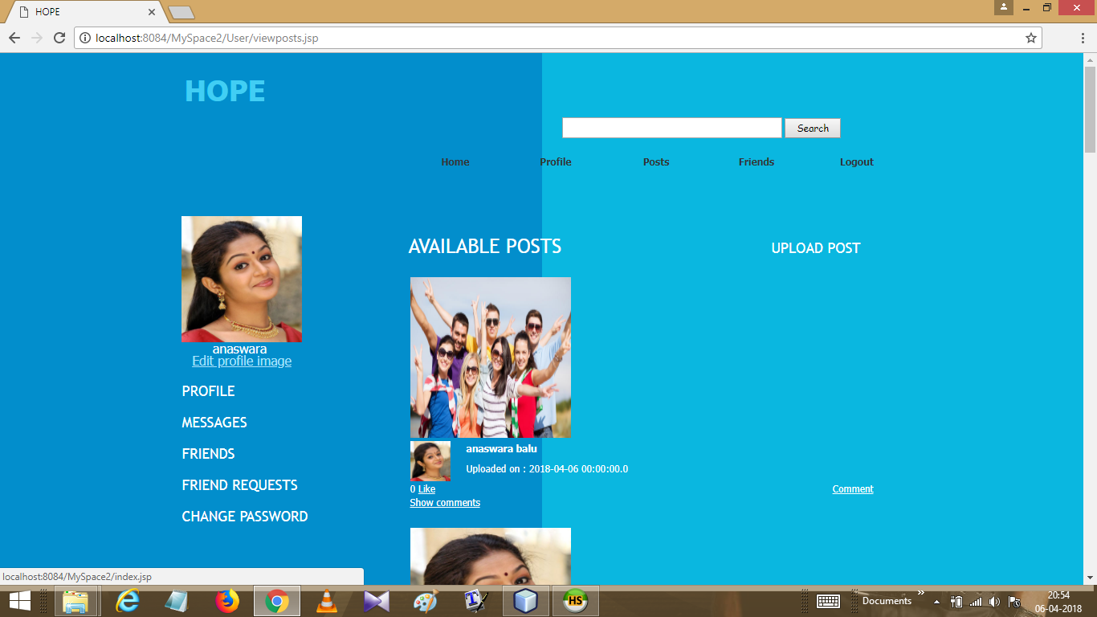

Slide 31
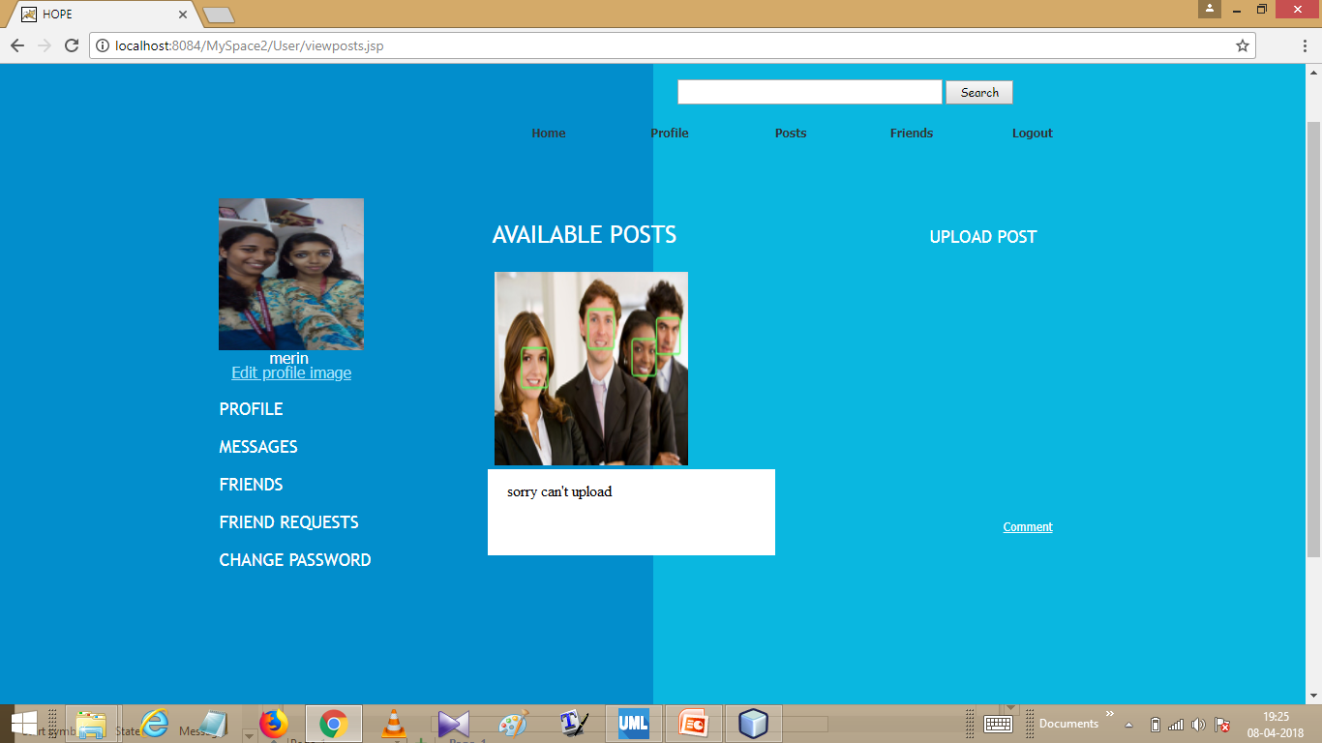

Slide 32
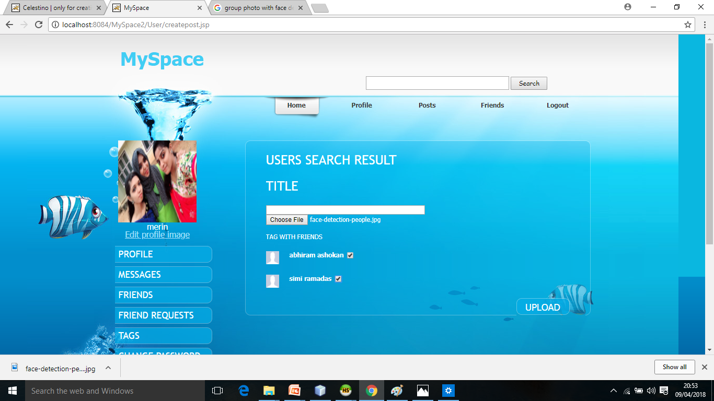

Slide 33
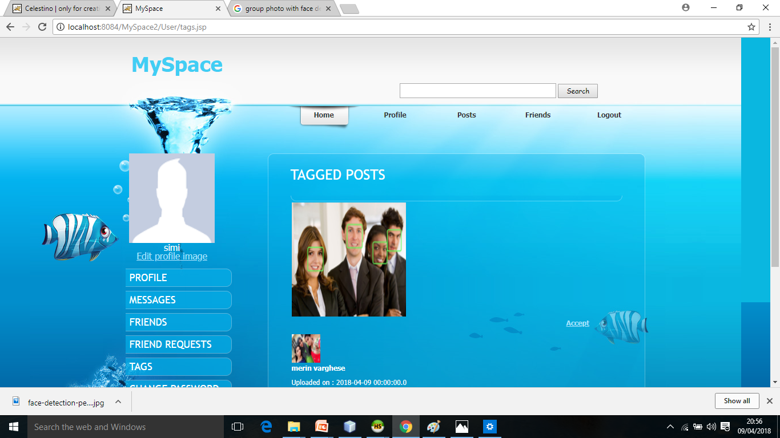

Slide 34
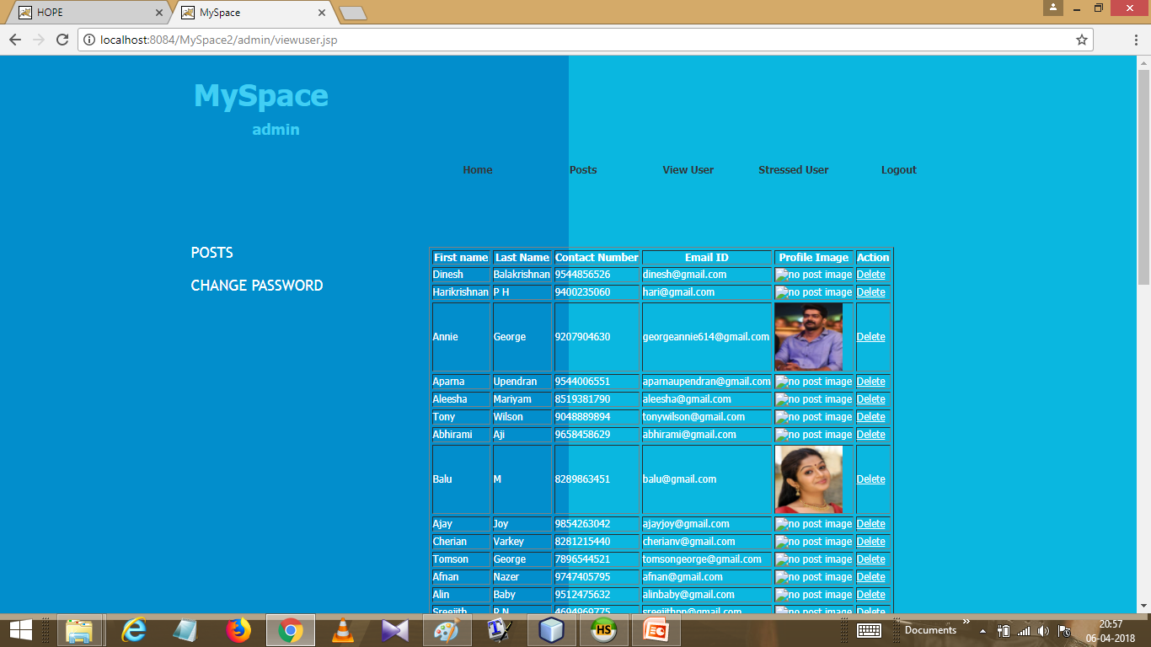

Slide 35
THANK U

